Slide 1
REALTEC
SANITUNELES CON GENERADORES DE OZONO
EN AYUDA CONTRA EL COVID-19

Slide 2
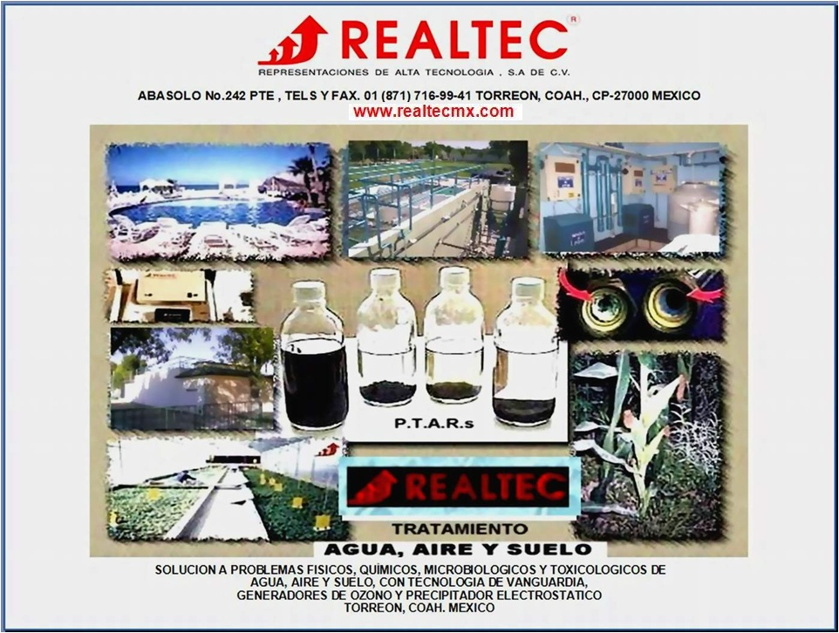

Slide 3
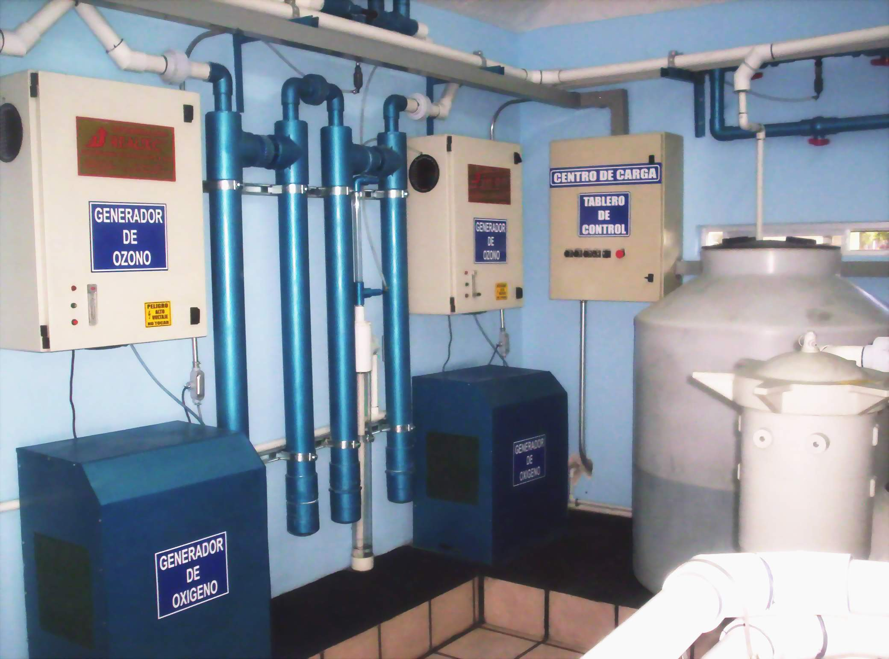


Slide 4
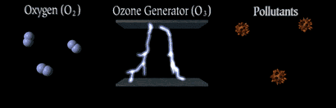
COMO TRABAJA EL OZONO

Slide 5
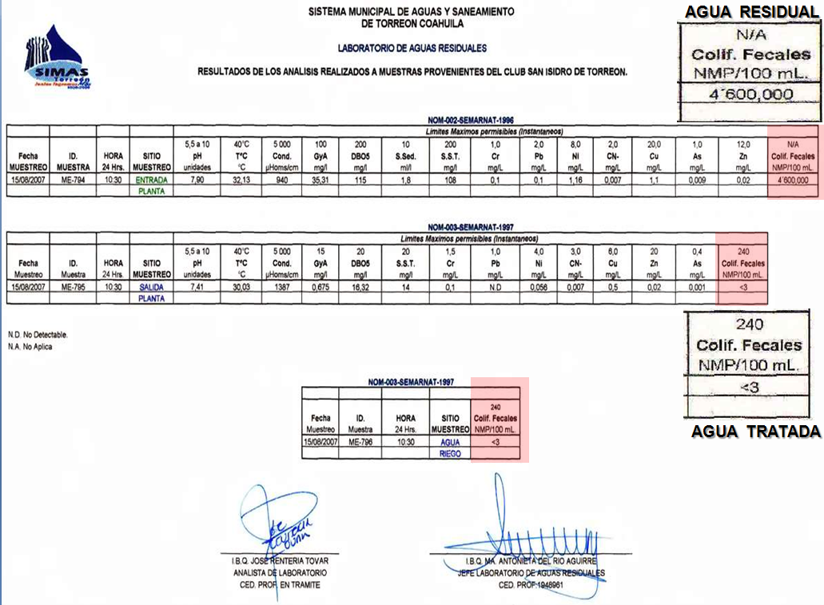

Slide 6
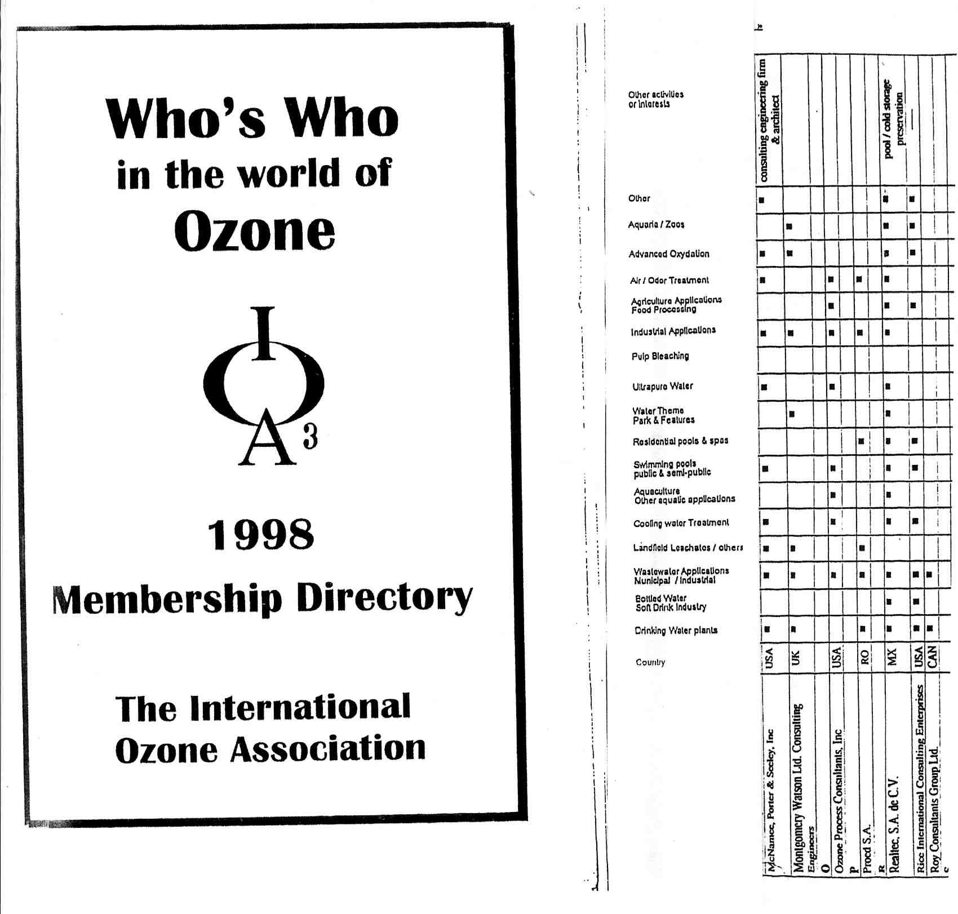
QUIEN ES QUIEN EN EL OZONO A NIVEL MUNDIAL

Slide 7
Scripps Scientists Address Mysteries Of Ozone In The Human Body
Date:
February 28, 2003
Source: Scripps Research Institute
Summary: In what is a first for biology, a team of investigators at The Scripps Research Institute (TSRI) is reporting that the human body makes ozone.
IN what is A FIRST FOR BIOLOGY investigators at The Scripps Research Institute (TSRI) is reporting that the human body makes Ozone.
Led by TSRI President Richard Lerner, Ph.D. and Associate Professor in the Department of Chemistry Paul Wentworth, Jr, Ph.D., who made the original discovery, the team has been slowly gathering evidence over the last few years that the human body produces the reactive gas--most famous as the ultraviolet ray-absorbing component of the ozone layer--as part of a mechanism to protect it from bacteria and fungi.
"Ozone was a big surprise," says TSRI Professor Bernard Babior, M.D., Ph.D.
"But it seems that biological systems manufacture Ozone, and that ozone has an effect on those biological systems."

Slide 8
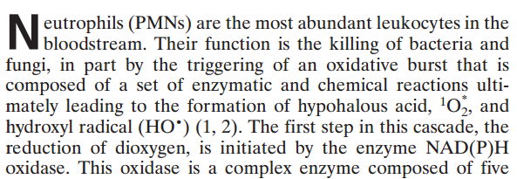
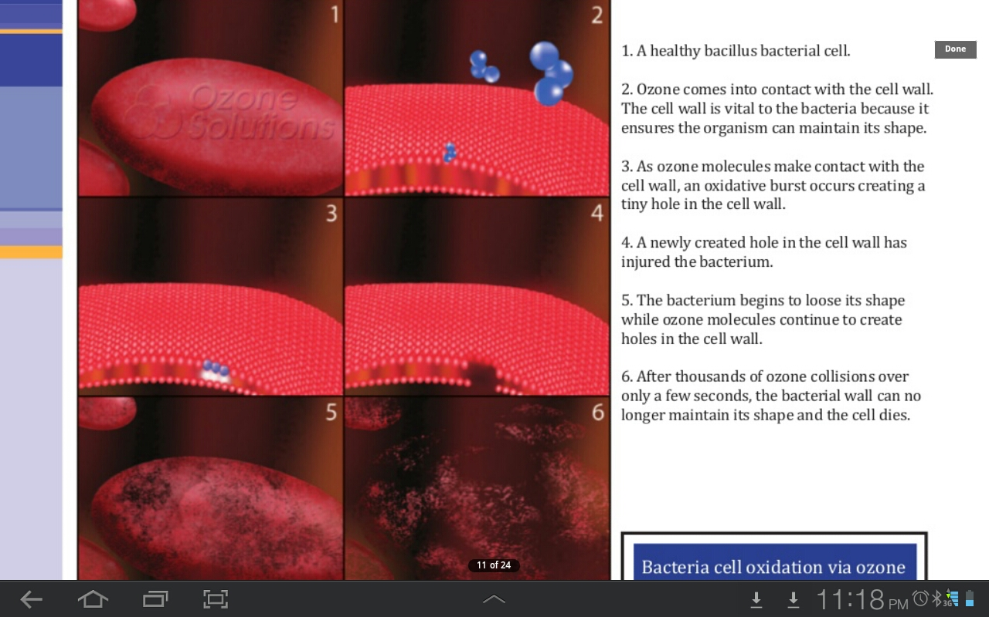
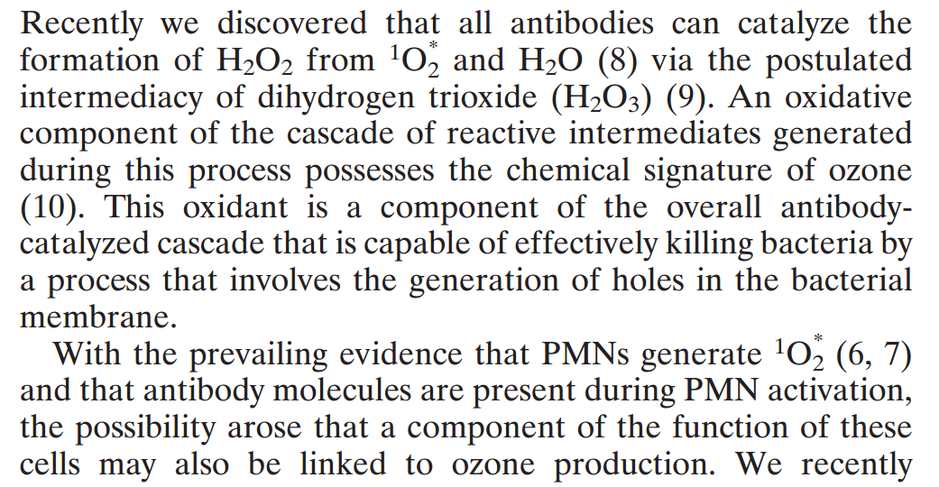

Slide 9
Frank A. Shallenberger, MD
Ozone therapy represents one form of alternative medicine that a doctor might offer his/her patients.
Ozone generators in medical offices are not the only places where ozone is made for medical reasons. It is also made in the human body by white blood cells and antibodies as part of the respiratory burst. According to researchers at The Scripps Research Institute, in addition to their direct effects for supporting a healthy immune response, white cells also feed singlet oxygen to antibodies, which convert it into Ozone.
The ozone produced by white cells in the body increases the robustness of the immune response. And it may be that this function of ozone therapy is one reason why it is such a powerful method to support cardiovascular health.
Several recent studies are pointing out that a major factor in the accumulation of unwanted fats and lipids in arteries is related to suboptimal immune function. A number of effects that result from this contribute to poor coronary and circulatory health. Many doctors including myself have found that the regular administration of ozone to patients for supporting cardiovascular health augments all other forms of therapy, and can significantly enhance cardiovascular function. This is probably at least partially due to ozone’s immune-boosting effect.

Slide 10

LOS TUNELES CON
OZONO
DEL “SISTEMA REALTEC”
OBTIENEN
LOS SIGUIENTES BENEFICIOS:
« 0 » Consumo de QUIMICOS DESINFECTANTES
Y EXCELENTE DESINFECCION DE VIRUS Y SUS ESPORAS
NO PRODUCE SUBSTANCIAS CARCINOGENETICAS

Slide 11
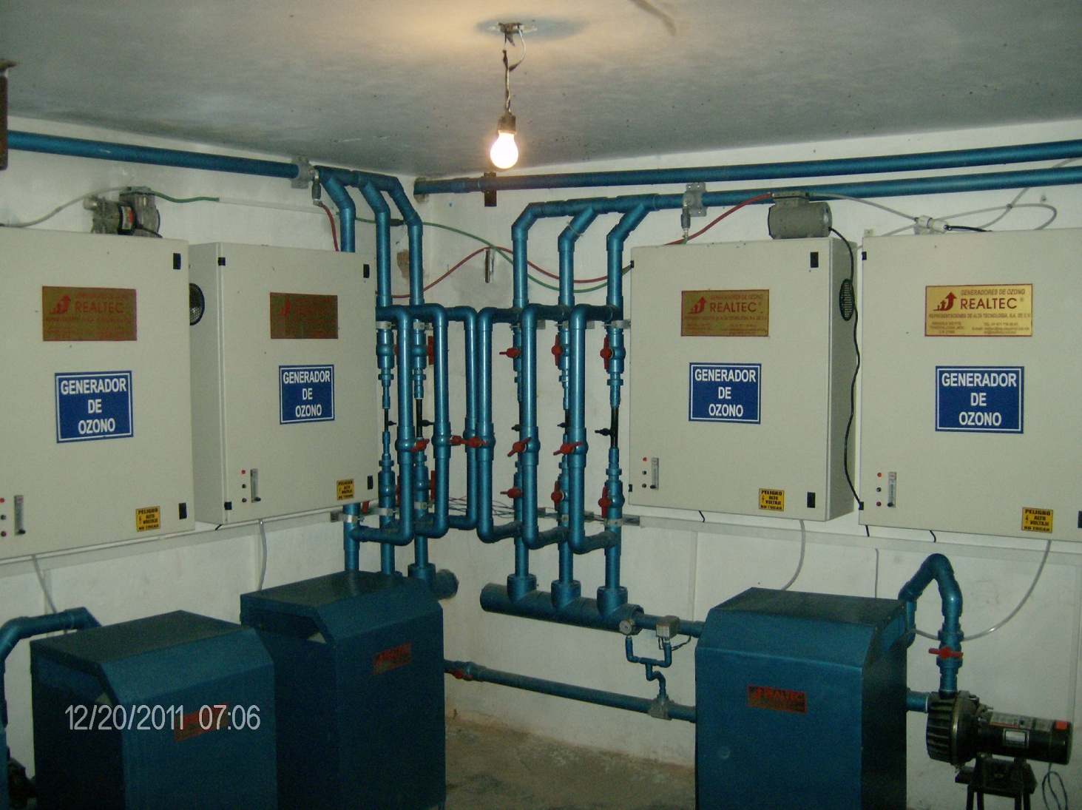

Slide 12
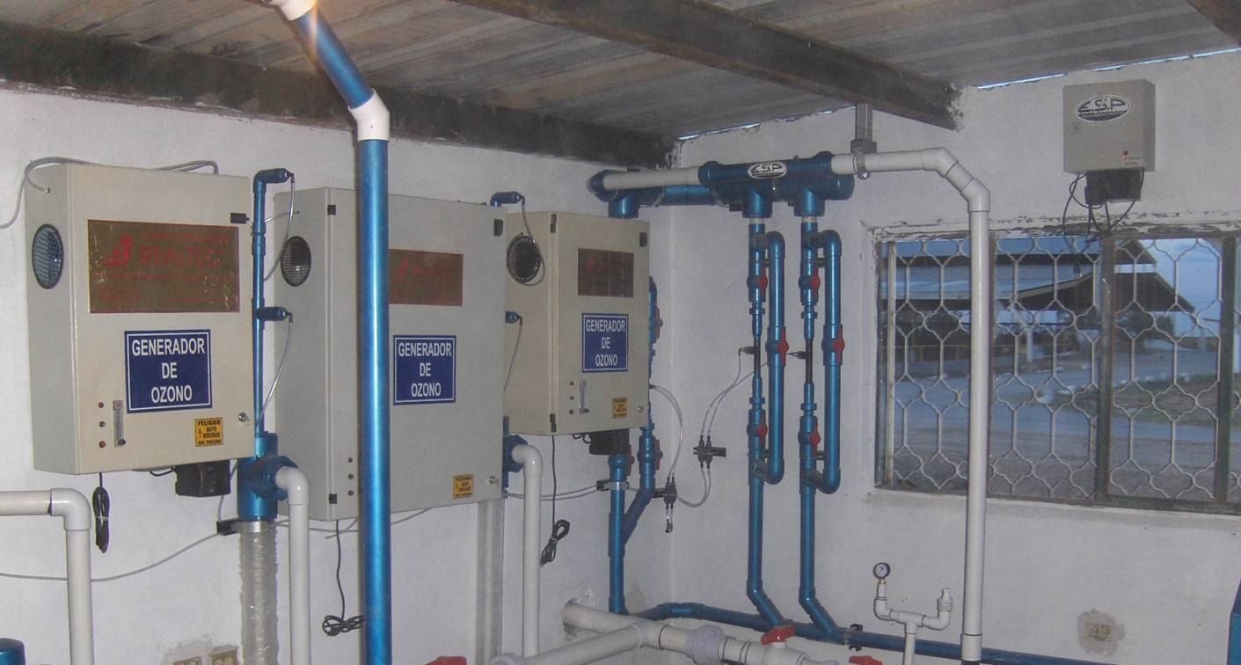
ESTABLO No.- 2
SISTEMA REALTEC

Slide 13
Frank A. Shallenberger, MD
Ozone therapy represents one form of alternative medicine that a doctor might offer his/her patients.
Ozone generators in medical offices are not the only places where ozone is made for medical reasons. It is also made in the human body by white blood cells and antibodies as part of the respiratory burst. According to researchers at The Scripps Research Institute, in addition to their direct effects for supporting a healthy immune response, white cells also feed singlet oxygen to antibodies, which convert it into Ozone.
The ozone produced by white cells in the body increases the robustness of the immune response. And it may be that this function of ozone therapy is one reason why it is such a powerful method to support cardiovascular health.
Several recent studies are pointing out that a major factor in the accumulation of unwanted fats and lipids in arteries is related to suboptimal immune function. A number of effects that result from this contribute to poor coronary and circulatory health. Many doctors including myself have found that the regular administration of ozone to patients for supporting cardiovascular health augments all other forms of therapy, and can significantly enhance cardiovascular function. This is probably at least partially due to ozone’s immune-boosting effect.

Slide 14
HOSPITAL GENERAL DOCENTE
“CAPITÁN ROBERTO RODRÍGUEZ FERNÁNDEZ” MORÓN
Efecto inmunomodulador de la ozonoterapia en niños con deficiencia en la inmunidad mediada por fagocitos.
Immunomodulator effect of ozone therapy in children with deficiency in immunity mediated by phagocytes.
Jacqueline Díaz Luis (1), Gisela Sardiñas Padrón (2), Silvia Menéndez Cepero (3), Consuelo Macías Abraham (4).
RESUMEN Se realizó un estudio pre-experimental antes después, con la finalidad de evaluar el efecto inmunomodulador de la ozonoterapia en niños con inmunodeficiencia por defectos en la inmunidad mediada por fagocitos. El universo estuvo constituido por un total de 18 niños con deficiencias en la fagocitosis, asistidos en la consulta de Inmunología en el periodo desde septiembre de 2009 hasta junio de 2010, que cumplieron con los criterios de inclusión y exclusión. El ozono se aplicó en dosis escalonadas por insuflación rectal hasta una concentración de 40µg/mL, durante tres meses. Las variables fueron evaluadas 1 mes después del tratamiento. Se determinó si existen diferencias significativas entre las determinaciones antes y después de la ozonoterapia, mediante la prueba T de comparación de medias para muestras dependientes, con un nivel de significación α=0.05. Hubo aumentos significativos del conteo absoluto de neutrófilos en el 100% de los casos y en el 94% mejoró significativamente la función fagocítica leucocitaria después de recibir la ozonoterapia. El estado clínico, cualitativamente evaluado, fue satisfactorio en los niños tratados con Ozono y no se reportaron reacciones adversas durante el tratamiento. Se sugiere este proceder terapéutico como alternativa terapéutica inmunoestimulante en la deficiencia fagocítica.
Palabras clave: INMUNODEFICIENCIA/terapia, OZONOTERAPIA/uso terapéutico.
Especialista de 2do Grado en Inmunología. Máster en Enfermedades Infecciosas. Investigador Agregado.
Licenciada en Enfermería.
Dra. en Ciencias Químicas y Especialista en ozonoterapia. Investigador Titular
Especialista de 2do Grado en Inmunología.Dra. en Ciencias médicas.Investigador Titular.

Slide 15


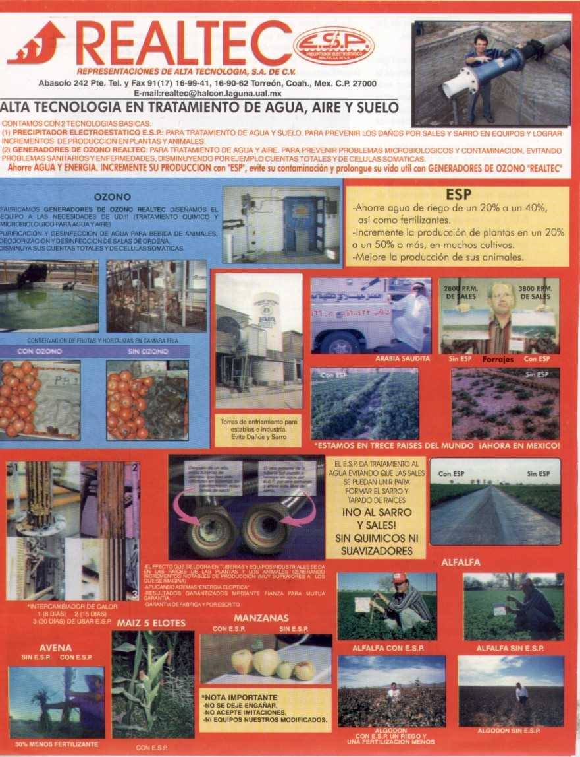
TORREON, COAH.
MEXICO
ABRIL 2020
REALTEC vs COVID-19
AVJ
CARRET. LA UNION LA PARTIDA Km.0.5
FRACCIONAMIENTO LA BARRANCA , CP.- 27405 , TORREON, COAH. MEXICO
(871)116-27-95 // (871) 716-99-411
< www.realtecmx.com>
< avj@realtecmx.com >
< realtecavj@gmail.com >
< realtectrn@yahoo.es >
Notes:
15

Slide 16
DESTRUCCION ORGANISMOS con OZONO
.avi

